Slide 1
The future of Learning
Strategy & trends
Content – will it change?
Learning Portal – is it a LMS?
Adrian Zuffi
Manager Learning Channel & Alliances

Slide 2
Think Different

Slide 3
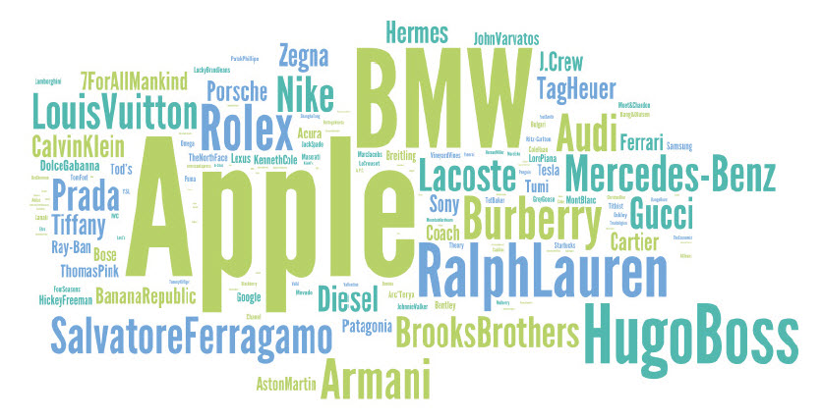
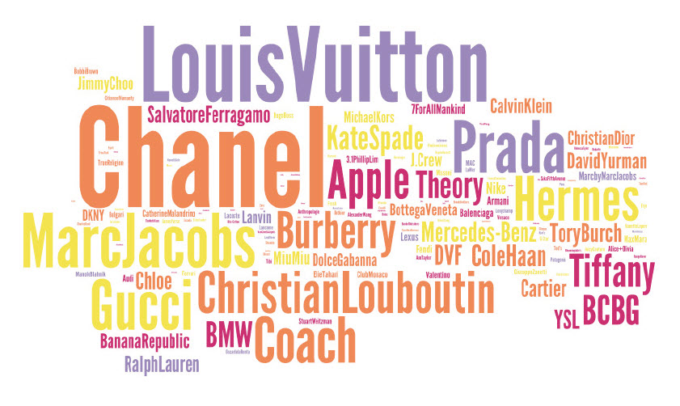
Generation Y: Design conscious

Slide 4
How do you teach Greg Justice?
Youtube link
Credit: John Ambrose, Skillsoft
Notes:
The Stanford University English major is working in Cisco’s communications department, and the company planned to have him write blog posts over the summer to generate buzz about the company and incorporate its products — including Flip camcorders and TelePresence videoconferencing.
The idea for the rap video came after a brainstorming session Mr. Justice had with his boss, John Earnhardt, Cisco’s director of corporate communications. They were inspired by the “World’s Most Interesting Man” campaign by Dos Equis beer, and Mr. Justice decided to call upon his rapping skills, which he had used in a group at Stanford, he said.
His supervisor, by the way, told Mr. Justice not to get his hopes up. “He said, ‘Don’t worry if you hear crickets after this, because 99.99% of attempts at viral video fail,’” Mr. Justice said.

Slide 5
If Greg is a challenge..... ........ how will you teach Gen Z!
Grown up with lifelong use of communications and media technologies such as:
World Wide Web
Instant messaging
Text messaging
MP3 players
Mobile phones
Smartphone
Touchscreen
iPhone
iPod
Zune
iPad
Tablets
YouTube
Twitter
Apps
Smart TV’s....

Slide 6
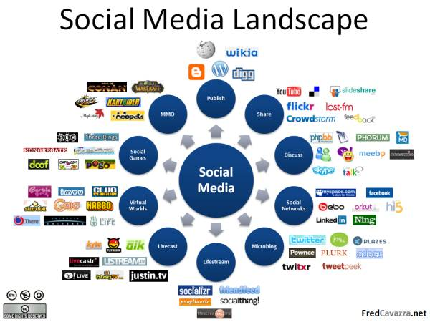
Taking advantage of external content

Slide 7
Focused content
Notes:
E-learning is becoming more modular with 5 minute “courses” a coming trend. The LMS needs to track a larger number of small courses and understand how to track those towards a larger curriculum or performance goals

Slide 8
User contribution
Notes:
The future LMS must open up and stimulate the end users wish and ability to produce, change or add to content. This while still making sure knowledge gained (whether it happens through formal or informal processes, ”being taught” or contributing) can still be tracked and measured to help you evaluate and improve your learning strategies. Social learning is important, but are we supporting it properly? The LMS needs to help you understand what to do and be part in enabling you to do it.

Slide 9
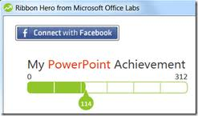
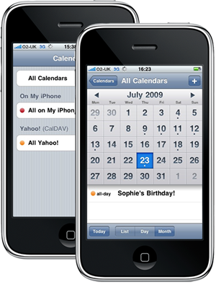
Context sensitive access and distribution
Notes:
Learning needs to find users in the context it addresses to a larger degree. The future LMS needs to be able to integrate, offer and track with other systems and devices. Examples of this are Offering speed-lessons from within another system or working with phones and other handhelds to offer and deliver suitable training based on location, tasks or appointments. Learning must present itself in the users natural workspaces.

Slide 10
November 2009: The world still is not ready for mobile learning
Gordon is still waiting for a suitable device for learning!

Slide 11
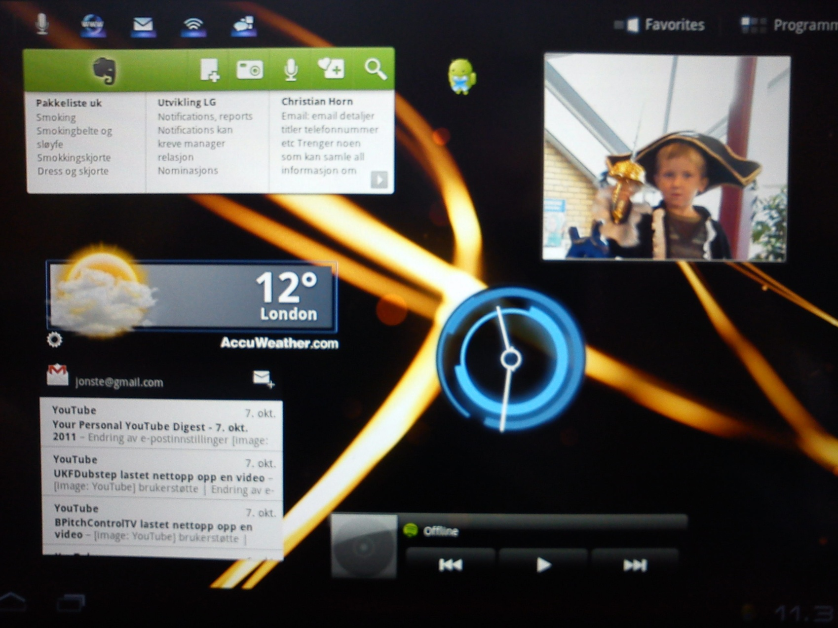
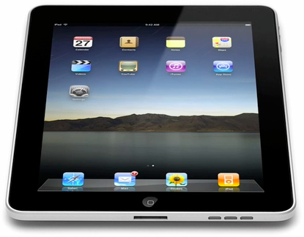
March 2012: The world has changed. Mobile devices are changing our expectations and behavior.

Slide 12
The learning ecosystem
Notes:
The future LMS must open up and stimulate the end users wish and ability to produce, change or add to content. This while still making sure knowledge gained (whether it happens through formal or informal processes, ”being taught” or contributing) can still be tracked and measured to help you evaluate and improve your learning strategies. Social learning is important, but are we supporting it properly? The LMS needs to help you understand what to do and be part in enabling you to do it.

Slide 13
Learning Portal or ”under the hood”? An LMS’s must do both
.... and you should be given the choice to offer both to your learners

Slide 14
What is a learning portal?
Traditional internal LMS
Notes:
Audiences have differents needs.
What’s wrong with the LMS’ of today?
LMS’ have traditionally catered to diverse needs by allowing you to control content access. Learning Gateway will give you control over the experience.
Bersin: Nr 1. reason for dissatifaction with LMS’. They can’t be customized to cater for diversing needs.

Slide 15
100% Interface Flexibility
Product Based
Training Interface
Corporate
Management University
Target specific interfaces designs to meet the training requirements and learning style of the audience.

Slide 16
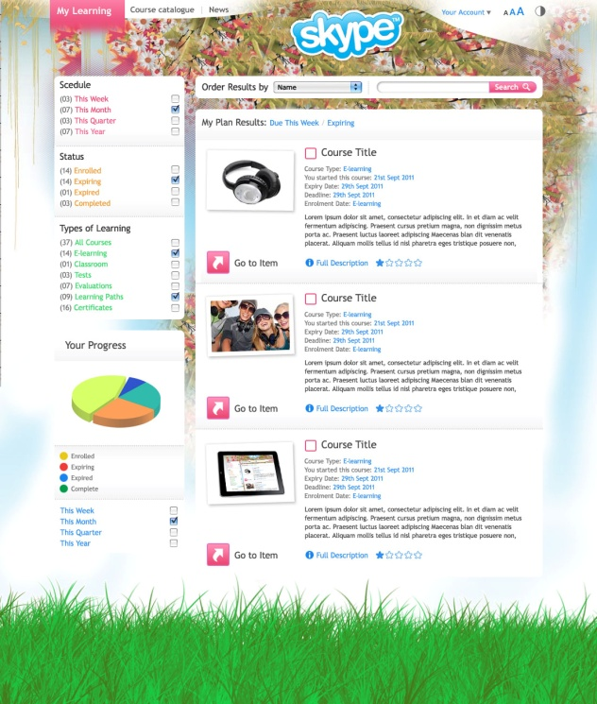
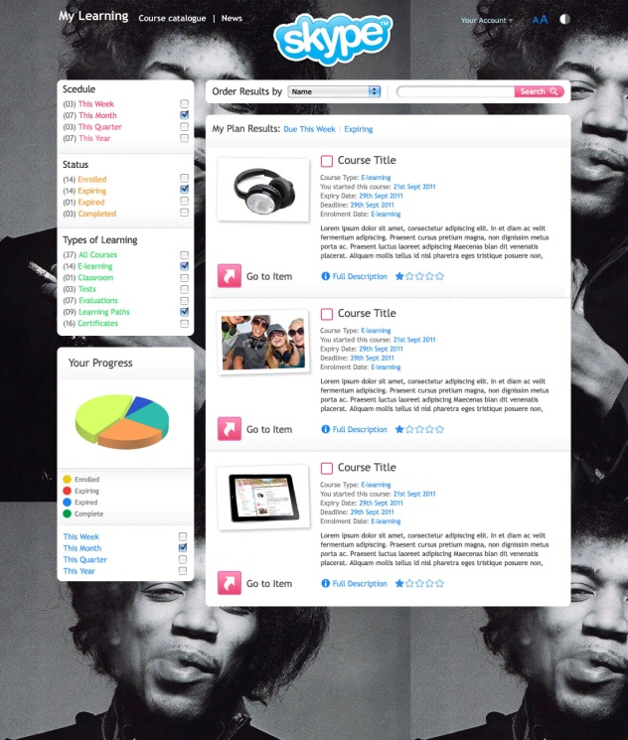
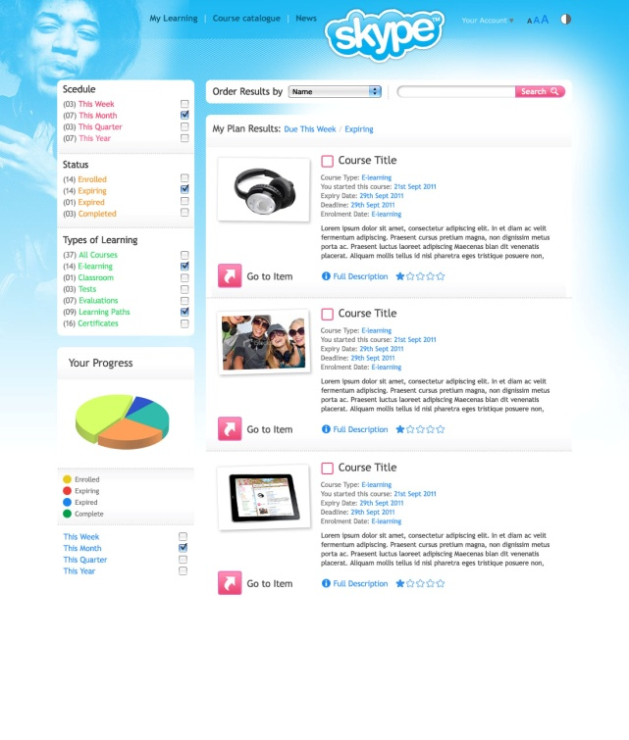
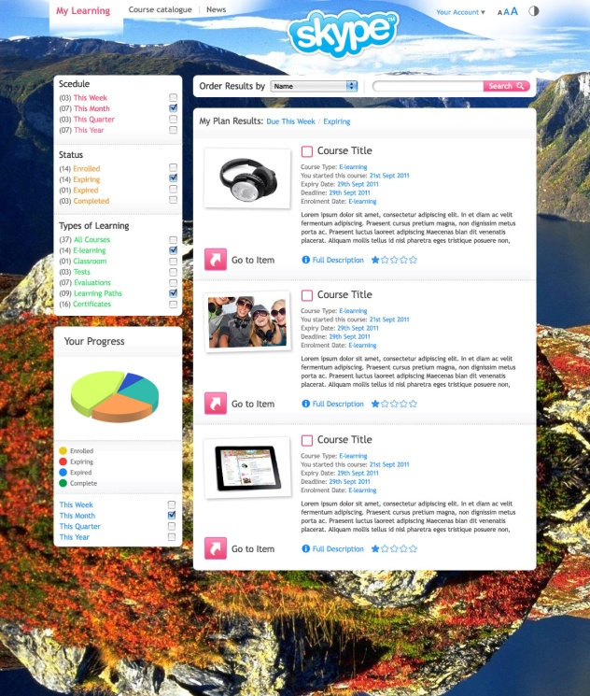

Slide 17
Example designs

Slide 18
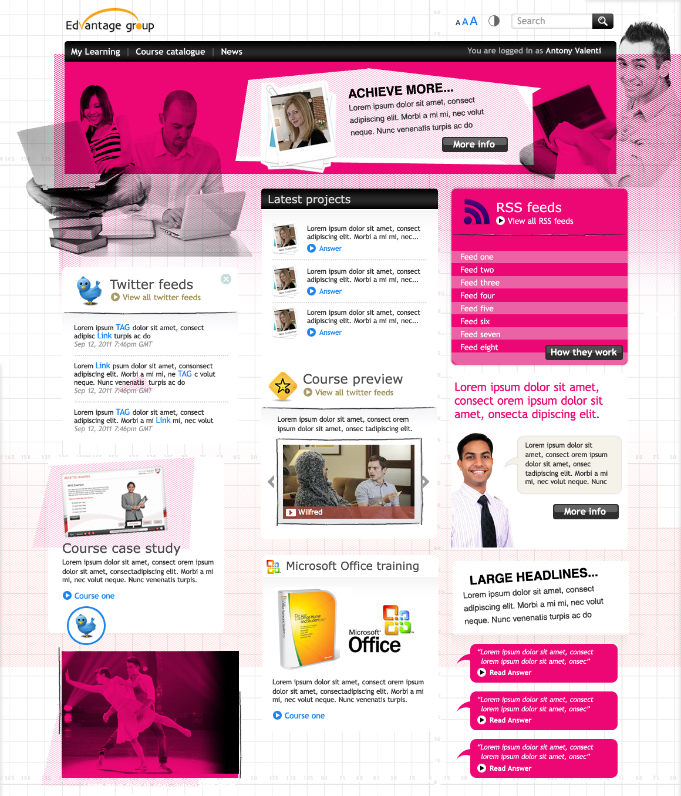

Slide 19
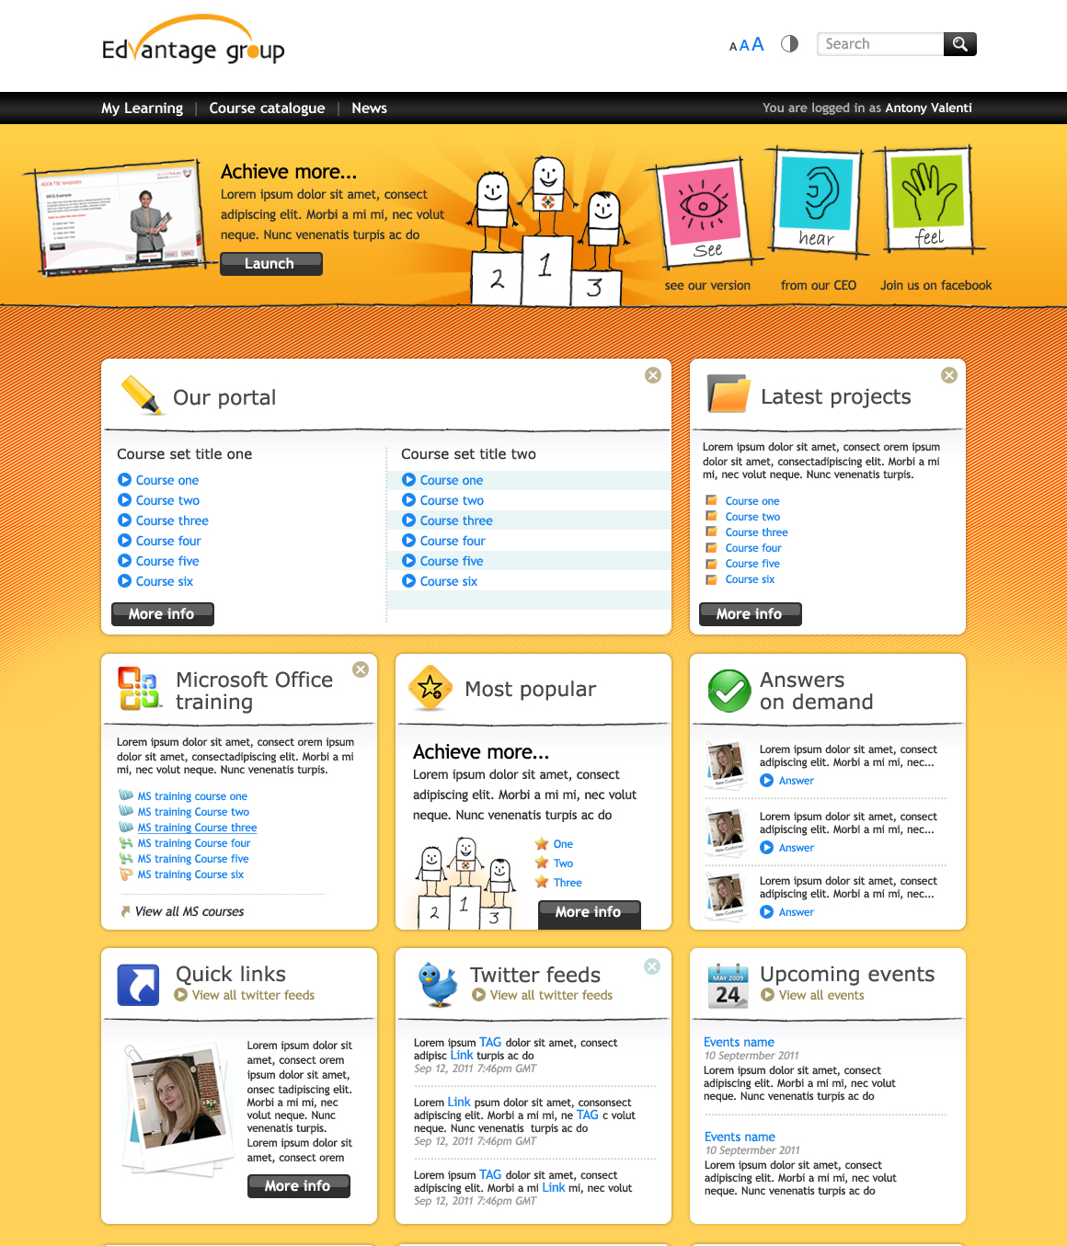

Slide 20
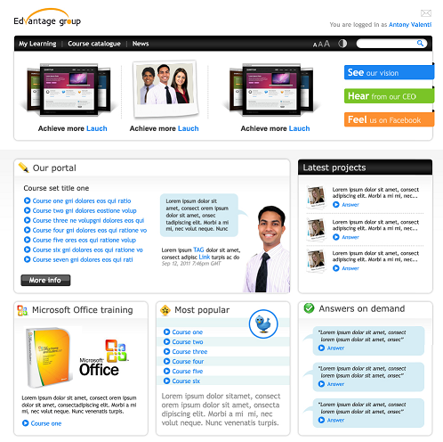
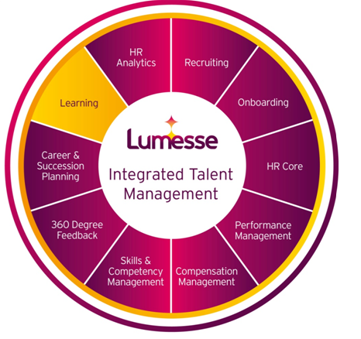
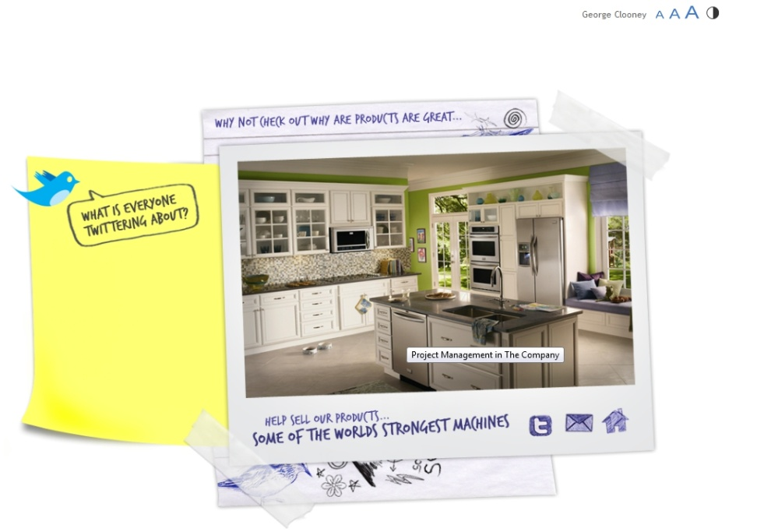
Final thoughts

Slide 21
Adrian Zuffi
Manager Learning Channel & Alliances
adrian.zuffi@lumesse.com
www.lumesse.com

