Slide 1
“We could have predicted
Eve
would have eaten the apple”
Vernon Bryce
Consulting Psychologist, Consulting Partner
Director and Principal , Kenexa an IBM Company
To us, business is personal
Axes Management New Year Club
14 December 2012

Slide 2
Agenda
Kenexa Overview
Our Psychometrics
Our Innovations
Questions?

Slide 3
KENEXA overview

Slide 4
STATURE AND REACH
Kenexa and our Partners assess more candidates
than anybody else in the world.
Kenexa are independently rated as providing our Partners with
the highest quality instruments and service in the industry
We provide demonstrable returns on investment through Business outcome studies
Kenexa’s global reach and infrastructure provides round the clock
support and local account management through our local Partners
Kenexa partners with Axes Management to provide demonstrable
returns on investment from the latest research.

Slide 5
QUICK FACTS
Revenue: $293M
Founded: 1987
Employee Population: 2,750
$43M:
Global Footprint: 32 Offices in 21 Countries
4,000 Customers
R&D
reinvestment
30M
Assessments
Employee research and software to help companies
HIRE THE ABSOLUTE VERY best people
AND MAXIMISE THEIR EXPERIENCE
and

Slide 6
Selected CLIENTS

Slide 7
OUR
Psychometrics

Slide 8
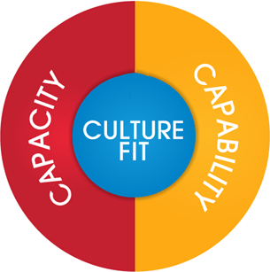
KENEXA PREDICTs
PREDICT
Measure individuals’ innate and acquired abilities
and how well they will fit your business’s unique culture
Innate Abilities
Acquired Abilities
Talent
Natural potential
Fit to role
Preference
Personality
Motivation
Intellect
Cognition
Ability
Experience
Leading a team
Customer service
Situational
Judgment
Most likely to do
Least likely to do
Impact
Mentoring others
Effective leadership
Alignment between individual & organization

Slide 9
Across THE employee life cycle
Mass Recruitment | Graduate Recruitment | Management & Professional | Leadership & Executive | Succession Planning | Development
Online Personality * Motivation * Face to Face Exercises
360/Multi-Rater feedback
Unsupervised Ability and Verification
Skills and Knowledge Assessments
Situational Judgement Tests * Simulations
RJPs * Culture Fit * RCPs

Slide 10
range of ability tests
Job Group | Job Level | Verbal | Numerical | Logical | Checking
Senior Manager & Graduate Level | Director & Senior Manager | √ | √ | √
 | Graduate | √ | √ | √
Manager Level | Middle & Junior Manager | √ | √ | √
Operational Level | Customer Service
 | Administrative

Slide 13
BENCHMARKING
Best practice in the creation of comparison groups stipulates that the data in these groups need to be up to date, as representative of the real applicant group as possible, and contain data of 150+ individuals.
The Kenexa approach fully meets these requirements by creating specific bespoke benchmark groups for our clients.
As well as employing a wide range of off the shelf benchmark groups

Slide 14
personality Assessment - OPI
The Kenexa Occupational Personality Inventory (OPI) is one of the most widely used and sophisticated measures of workplace behavioural style. It has 250 items and can be completed in 30-40 minutes. It is ideal for Directors Managers and Graduates.
It sets the highest standard of measurement excellence. It has 6 main factors and 24 sub-scales. Full training is required.
Provides a clear framework for understanding the impact of personality on job performance and very detailed expert reports.
Thousands of assessments taken every year, through our Partners across many countries and industries.

Slide 15
Reporting power
A wide range of standard and bespoke report options are available providing meaningful interpretation for our Partners’ HR managers.
Highly targeted & user-friendly.
Detailed, highlighting potential strengths & areas for development.
Most are designed for direct use by line managers.
Clear graphical summaries of performance against job competencies.

Slide 16
Bespoke reporting
Fully customised OPI Output:
Fully Branded
Mapped to client competencies
Can include static & dynamic interview questions
Can include development advice
Symbol | Short description | Definition
✓✓ | Key strength | Very likely to have a positive impact
✓ | Likely strength | Likely to have a positive impact
● | Moderate | Likely to have neither a positive or negative impact
✗ | Likely limitation | Likely to have a negative impact
✗✗ | Key limitation | Very likely to have a negative impact

Slide 17
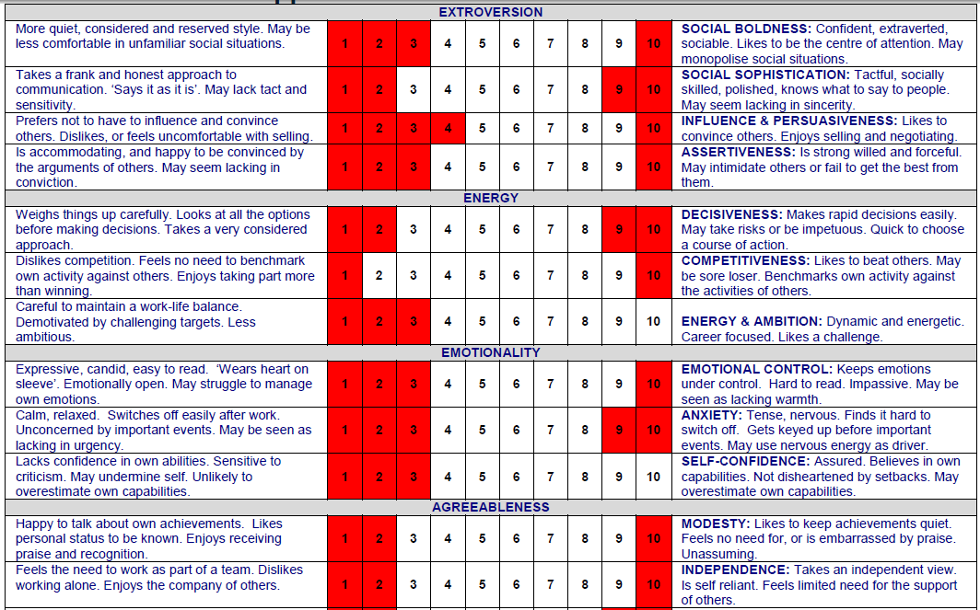
Danger Zones - EVE?

Slide 18
Personality Assessment – RPQ & PIP
The Kenexa Rapid Personality Questionnaire (RPQ) is designed specifically for probing more deeply than PIP below yet without the time and depth and detail associated with OPI.
It has 80 questions. based on the 6 factor OPI structure and research.
It can be completed in 5-10 minutes, with simple instructions.
Ideal for recruitment decisions for staff up to Middle Manager level.
The Personality Interview Profiler (PIP) is designed for all jobs and can stand alone or integrate into recruitment processes or software.
It has 66 items, 8 key traits and can be completed in 5-10 minutes
No expert training and certification is required by decision makers

Slide 19
LEADERSHIP & MOTIVATION solutions
Unique to Kenexa, the Leadership Preference Indicator (LPI) is a short 28 item on-line questionnaire for assessing a person’s preference to allow them to emerge as a successful leader.
It takes 7-10 minutes yet it is based on deeper 28 dimension research
It is best applied to screening leadership talent in selection, promotion, development planning, graduate recruitment or talent identification.
Kenexa’s Motivation Questionnaire (MQ) measures how motivated a person is and how motivated they are on normative 12 scales.
Can be used for selection, on-boarding and development
Based on Needs Theories (physiological, intrapersonal, interpersonal)

Slide 20
innovations

Slide 21
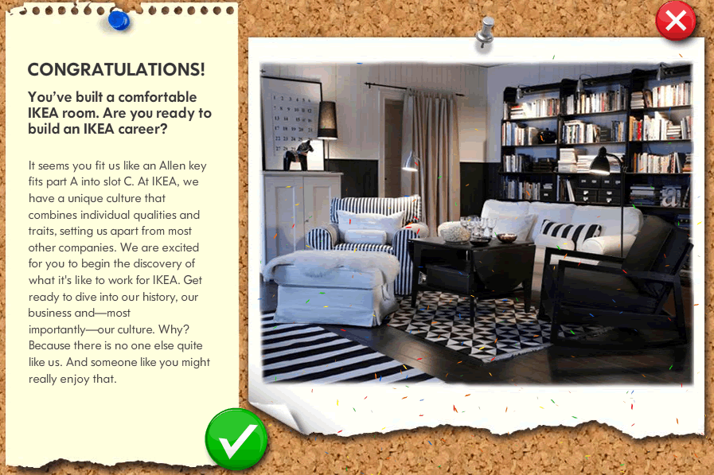
Branding/Culture
IKEA Screenshots

Slide 22
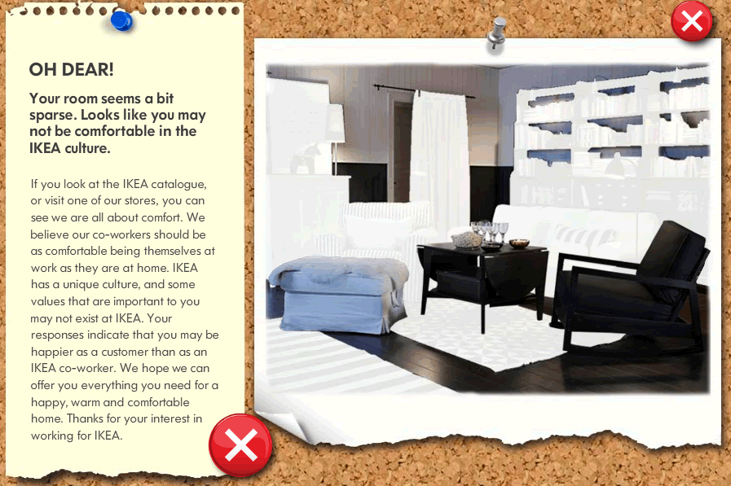
Branding/Culture
IKEA Screenshots

Slide 23
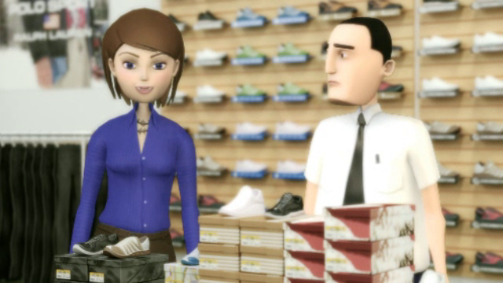
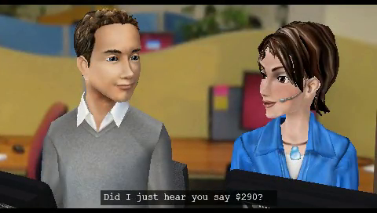
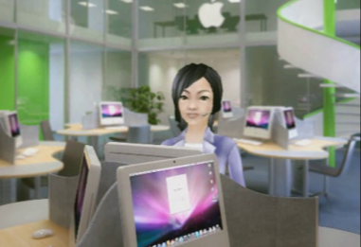
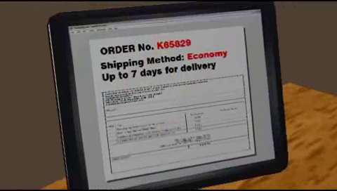
SIMULATED Situational Judgement

Slide 24
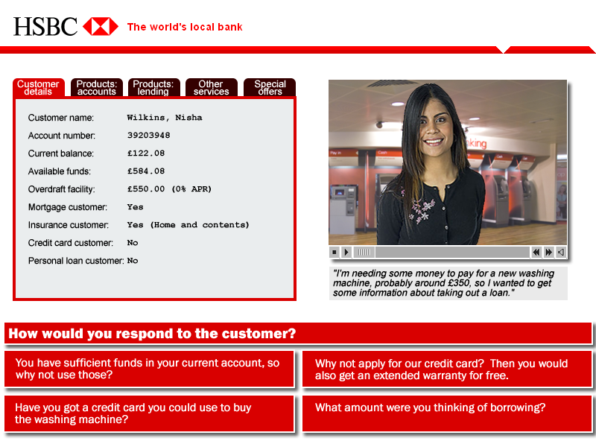
tabs to identify cross-selling opportunities. Candidates can use additional information on these
Candidates must read and interpret simple numerical information.
Video of customer inquiring.
Subtitles.

Slide 25
Why simulations?
Professional quality production
realistic environments and character “design to fit”
animation and voice reality projection
Completely customised
to Partners’ clients’ requirements: branding, environment
character contextualised appearance and rapid deployment
Award Winning
Top Ten HR Product of 2008 (HR Executive Magazine)
Shortlisted, CODiE Award 2009 (SIIA)

Slide 26
Research and Validity
“DEFINE MEASURE DECIDE EVALUATE”
(Bersin’s* 4 Step Model November 2012)
Existing research indicates:
Assessments which closely simulate the job achieve higher validity.
Candidates with poor literacy can be assessed more accurately with multimedia assessments.
Use of multimedia results in lower adverse impact against ethnic groups who typically score lower on measures of verbal reasoning.
Candidate reaction to novel assessments is more positive
*Bersin ‘s Analysts are internationally recognised as the leading HR Best Practice Researchers .

Slide 27
BEST PRACTICE
…is only as good as the underlying system capabilities:
It must be available and reliable around the clock
99.95% availability
It must be secure
ISO27001 Certified
It must perform even under peak loads
30 million assessments delivered per year
It must be future-proof
Service oriented architecture allows scalability, updates, content refresh, new innovations and rapid configuration

Slide 28
QUESTIONS?

